Slide 1




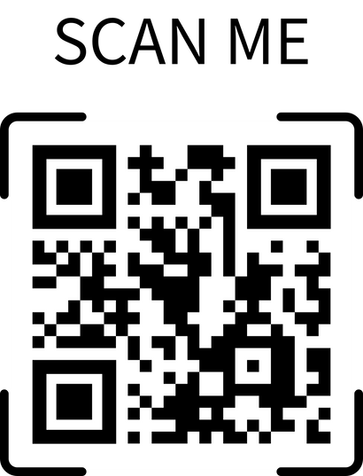

Beyond Basic Prompts
AI for Productivity
Presented By:
Allison Banks
Paired Handout ~
Take notes & practice!

Slide 2
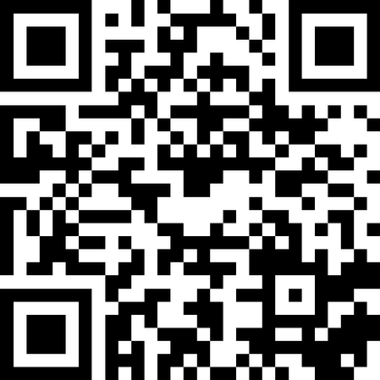

Quick Poll
Daily
How often do you use AI tools (e.g., ChatGPT, Copilot, Gemini)?
Occasionally
Rarely
Never
Slido.com
Use the code # 2885296

Slide 3
Overview
This interactive session moves beyond AI basics to explore how to think like a designer when prompting.
You’ll learn to apply advanced prompting strategies, practice refining outputs, & discuss responsible use - all through real workplace examples.

Slide 4

Overview
This interactive session moves beyond AI basics to explore how to think like a designer when prompting.
You’ll learn to apply advanced prompting strategies, practice refining outputs, & discuss responsible use - all through real workplace examples.
🛠️Apply advanced prompting strategies to enhance everyday tasks.
Objectives
🔄️Refine & improve AI outputs through iterative prompting for precision, tone, & clarity.
⚖️Identify ethical & responsible AI practices to ensure professional, secure, & transparent use.

Slide 5

Beyond Basic Prompts → What That Means
Move from “asking” to collaborating with AI.
“Write an email about our upcoming staff meeting.”
Advanced prompting = clearer direction + higher quality + less editing

Slide 6
Beyond Basic Prompts → What That Means
Move from “asking” to collaborating with AI.
“Write an email about our upcoming staff meeting.”
  Vague request
  AI fills in too many blanks
  Generic & often inaccurate
Advanced prompting = clearer direction + higher quality + less editing

Slide 7
Beyond Basic Prompts → What That Means
Move from “asking” to collaborating with AI.
“Write an email about our upcoming staff meeting.”
  Vague request
  AI fills in too many blanks
  Generic & often inaccurate
“Act as a communication specialist. Draft an empathetic, professional email to staff summarizing key takeaways from our Monday meeting. Keep it under 150 words & close with a call to action.”
Advanced prompting = clearer direction + higher quality + less editing

Slide 8
Beyond Basic Prompts → What That Means
Move from “asking” to collaborating with AI.
“Write an email about our upcoming staff meeting.”
  Vague request
  AI fills in too many blanks
  Generic & often inaccurate
“Act as a communication specialist. Draft an empathetic, professional email to staff summarizing key takeaways from our Monday meeting. Keep it under 150 words & close with a call to action.”
  Gives AI a role & tone
  Includes purpose, audience, and format
  Produces more accurate, human-like output
Advanced prompting = clearer direction + higher quality + less editing

Slide 9
Anatomy of a Strong Prompt
ROLE + TASK + CONTEXT
+ CONSTRAINTS + OUTPUT FORMAT
🧑‍💼Role
Defines the AI’s perspective, expertise, or tone.
“Act as a bookkeeper with experience managing small business finances.”
💡 When each part is clear, the AI delivers exactly what you need — faster and cleaner.

Slide 10
Anatomy of a Strong Prompt
ROLE + TASK + CONTEXT
+ CONSTRAINTS + OUTPUT FORMAT
🧑‍💼Role | 🎯Task
Defines the AI’s perspective, expertise, or tone. | Describes the exact action you want the AI to perform.
“Act as a bookkeeper with experience managing small business finances.” | “…organize last month’s expense categories into clear summaries.”
💡 When each part is clear, the AI delivers exactly what you need — faster and cleaner.

Slide 11
Anatomy of a Strong Prompt
ROLE + TASK + CONTEXT
+ CONSTRAINTS + OUTPUT FORMAT
🧑‍💼Role | 🎯Task | 🏢Context
Defines the AI’s perspective, expertise, or tone. | Describes the exact action you want the AI to perform. | Adds situational details that guide relevance and tone.
“Act as a bookkeeper with experience managing small business finances.” | “…organize last month’s expense categories into clear summaries.” | “…for a local yoga studio preparing quarterly tax records.”
💡 When each part is clear, the AI delivers exactly what you need — faster and cleaner.

Slide 12
Anatomy of a Strong Prompt
ROLE + TASK + CONTEXT
+ CONSTRAINTS + OUTPUT FORMAT
🧑‍💼Role | 🎯Task | 🏢Context | ⌚Constraints
Defines the AI’s perspective, expertise, or tone. | Describes the exact action you want the AI to perform. | Adds situational details that guide relevance and tone. | Sets limits for time, word count, or style.
“Act as a bookkeeper with experience managing small business finances.” | “…organize last month’s expense categories into clear summaries.” | “…for a local yoga studio preparing quarterly tax records.” | “…keep it under 200 words and include two key insights.”
💡 When each part is clear, the AI delivers exactly what you need — faster and cleaner.

Slide 13
Anatomy of a Strong Prompt
ROLE + TASK + CONTEXT
+ CONSTRAINTS + OUTPUT FORMAT
🧑‍💼Role | 🎯Task | 🏢Context | ⌚Constraints | 📊Output Format
Defines the AI’s perspective, expertise, or tone. | Describes the exact action you want the AI to perform. | Adds situational details that guide relevance and tone. | Sets limits for time, word count, or style. | Tells AI how to deliver the result visually or structurally.
“Act as a bookkeeper with experience managing small business finances.” | “…organize last month’s expense categories into clear summaries.” | “…for a local yoga studio preparing quarterly tax records.” | “…keep it under 200 words and include two key insights.” | “…present the results in a 2-column table labeled Category and Total.”
💡 When each part is clear, the AI delivers exactly what you need — faster and cleaner.

Slide 14

Practice 1: Drafting a Polished Email
Practice turning a basic request into a polished, professional AI-drafted email.
💡Choose one scenario (or create your own)
⌚Option 1: Timesheet Reminder
“You need to remind staff to submit timesheets by Friday at 3 PM.”
Use the formula from Slide 5:
ROLE + TASK + CONTEXT
+ CONSTRAINTS + OUTPUT FORMAT
📅 Option 2: Meeting Reminder
“You’re sending a reminder about tomorrow’s 10 AM department meeting.”
🎉 Option 3: Event Invitation
“You’re inviting colleagues to an upcoming professional development event.”

Slide 15

Practice 1: Drafting a Polished Email
Practice turning a basic request into a polished, professional AI-drafted email.
💡Choose one scenario (or create your own)
⌚Option 1: Timesheet Reminder
“You need to remind staff to submit timesheets by Friday at 3 PM.”
Use the formula from Slide 5:
ROLE + TASK + CONTEXT
+ CONSTRAINTS + OUTPUT FORMAT
📅 Option 2: Meeting Reminder
“You’re sending a reminder about tomorrow’s 10 AM department meeting.”
🎉 Option 3: Event Invitation
“You’re inviting colleagues to an upcoming professional development event.”
  What worked well in your email draft?
  What felt “off” or too generic?
  Which part of your prompt made the biggest difference?
  How could you iterate to make it sound more human, or more you?

Slide 16


Prompt Chaining & Iteration
🪜 Initial → Refine → Format → Polish
💡Initial
“Act as a bookkeeper and summarize this month’s expenses for a small yoga studio.”
Why Iterate?
  Teaches AI your expectations.
  Treat outputs like drafts — revise & redirect.
  Collaboration mindset: You + AI = co-creators.
🔁 Iteration = Evolution
Every prompt makes it smarter.

Slide 17


Prompt Chaining & Iteration
🪜 Initial → Refine → Format → Polish
💡Initial
“Act as a bookkeeper and summarize this month’s expenses for a small yoga studio.”
🛠️ Refine
“Now categorize expenses into supplies, marketing, and utilities with totals for each.”
Why Iterate?
  Teaches AI your expectations.
  Treat outputs like drafts — revise & redirect.
  Collaboration mindset: You + AI = co-creators.
🔁 Iteration = Evolution
Every prompt makes it smarter.

Slide 18


Prompt Chaining & Iteration
🪜 Initial → Refine → Format → Polish
💡Initial
“Act as a bookkeeper and summarize this month’s expenses for a small yoga studio.”
🛠️ Refine
“Now categorize expenses into supplies, marketing, and utilities with totals for each.”
📃Format
Why Iterate?
  Teaches AI your expectations.
  Treat outputs like drafts — revise & redirect.
  Collaboration mindset: You + AI = co-creators.
“Format the summary as a table with columns for category, amount, and percent of total.”
🔁 Iteration = Evolution
Every prompt makes it smarter.

Slide 19


Prompt Chaining & Iteration
🪜 Initial → Refine → Format → Polish
💡Initial
“Act as a bookkeeper and summarize this month’s expenses for a small yoga studio.”
🛠️ Refine
“Now categorize expenses into supplies, marketing, and utilities with totals for each.”
📃Format
✨Polish
Why Iterate?
  Teaches AI your expectations.
  Treat outputs like drafts — revise & redirect.
  Collaboration mindset: You + AI = co-creators.
“Format the summary as a table with columns for category, amount, and percent of total.”
“Add a short narrative summary and make the tone professional yet friendly.”
🔁 Iteration = Evolution
Every prompt makes it smarter.

Slide 20

Practice 2: Iterative Prompting Challenge
⭐Draft → Refine → Polish
Choose one of the following mini-challenges.
⟶ You’ll refine the AI’s response in three rounds, using feedback &constraints to improve clarity, tone, & accuracy.
💼 Option 1: Student Email
“A student emailed you about missing an assignment — respond empathetically & clearly.”
📅 Option 2: Event Recap
“Write a post-event summary for a recent PD session or student orientation.”
🪜Round 1: Basic prompt → get your first output
🛠️Round 2: Add a role, tone, or constraint
“sound warmer,” “use bullet points”
✨Round 3: Ask for improvements
“Make it more concise and positive.”

Slide 21
Practice 2: Iterative Prompting Challenge
⭐Draft → Refine → Polish
Choose one of the following mini-challenges.
⟶ You’ll refine the AI’s response in three rounds, using feedback &constraints to improve clarity, tone, & accuracy.
💼 Option 1: Student Email
“A student emailed you about missing an assignment — respond empathetically & clearly.”
📅 Option 2: Event Recap
“Write a post-event summary for a recent PD session or student orientation.”
🪜Round 1: Basic prompt → get your first output
🛠️Round 2: Add a role, tone, or constraint
“sound warmer,” “use bullet points”
  How did each revision change the output?
  What small tweak had the biggest impact?
  What will you start doing differently in your daily AI use?
✨Round 3: Ask for improvements
“Make it more concise and positive.”

Slide 22



AI in the Workplace: Ethical Boundaries
AI can boost efficiency — but we must protect privacy, uphold integrity, & think critically before we share or generate content.
🧑‍🎓 Student Data
Never paste grades, names, or identifying info into AI tools.
🔒 Responsible use = protect data + verify outputs + use judgment.

Slide 23
AI in the Workplace: Ethical Boundaries
AI can boost efficiency — but we must protect privacy, uphold integrity, & think critically before we share or generate content.
🧑‍🎓 Student Data
Never paste grades, names, or identifying info into AI tools.
📄 Confidential Info
Avoid sharing internal memos, HR details, or sensitive drafts.
🔒 Responsible use = protect data + verify outputs + use judgment.

Slide 24
AI in the Workplace: Ethical Boundaries
AI can boost efficiency — but we must protect privacy, uphold integrity, & think critically before we share or generate content.
🧑‍🎓 Student Data
Never paste grades, names, or identifying info into AI tools.
📄 Confidential Info
Avoid sharing internal memos, HR details, or sensitive drafts.
🧠 Bias & Accuracy
Verify all AI outputs — it can “sound right” but be wrong.
🔒 Responsible use = protect data + verify outputs + use judgment.

Slide 25
AI in the Workplace: Ethical Boundaries
AI can boost efficiency — but we must protect privacy, uphold integrity, & think critically before we share or generate content.
🧑‍🎓 Student Data
Never paste grades, names, or identifying info into AI tools.
📄 Confidential Info
Avoid sharing internal memos, HR details, or sensitive drafts.
🧠 Bias & Accuracy
Verify all AI outputs — it can “sound right” but be wrong.
🪪 Authorship & Credit
Acknowledge when AI assists in writing or idea generation.
🔒 Responsible use = protect data + verify outputs + use judgment.

Slide 26
This or That?
Read each scenario. Decide YES (appropriate) or NO (not okay).
📨 “You ask AI to rewrite a student’s reflection to make it sound better.” | ❌ No - student voice must stay authentic.

Slide 27
This or That?
Read each scenario. Decide YES (appropriate) or NO (not okay).
📨 “You ask AI to rewrite a student’s reflection to make it sound better.” | ❌ No - student voice must stay authentic.

Slide 28
This or That?
📨 “You ask AI to rewrite a student’s reflection to make it sound better.” | ❌ No - student voice must stay authentic.
🧾 “You paste a short, de-identified policy paragraph to make it easier to read.” | ✅ Yes - fine if no private data is shared.
Read each scenario. Decide YES (appropriate) or NO (not okay).

Slide 29
This or That?
📨 “You ask AI to rewrite a student’s reflection to make it sound better.” | ❌ No - student voice must stay authentic.
🧾 “You paste a short, de-identified policy paragraph to make it easier to read.” | ✅ Yes - fine if no private data is shared.
Read each scenario. Decide YES (appropriate) or NO (not okay).

Slide 30
This or That?
📨 “You ask AI to rewrite a student’s reflection to make it sound better.” | ❌ No - student voice must stay authentic.
🧾 “You paste a short, de-identified policy paragraph to make it easier to read.” | ✅ Yes - fine if no private data is shared.
👩‍🏫 “You upload a class roster to personalize outreach emails.” | ❌ No - roster = protected student data.
Read each scenario. Decide YES (appropriate) or NO (not okay).

Slide 31
This or That?
📨 “You ask AI to rewrite a student’s reflection to make it sound better.” | ❌ No - student voice must stay authentic.
🧾 “You paste a short, de-identified policy paragraph to make it easier to read.” | ✅ Yes - fine if no private data is shared.
👩‍🏫 “You upload a class roster to personalize outreach emails.” | ❌ No - roster = protected student data.
Read each scenario. Decide YES (appropriate) or NO (not okay).

Slide 32
This or That?
📨 “You ask AI to rewrite a student’s reflection to make it sound better.” | ❌ No - student voice must stay authentic.
🧾 “You paste a short, de-identified policy paragraph to make it easier to read.” | ✅ Yes - fine if no private data is shared.
👩‍🏫 “You upload a class roster to personalize outreach emails.” | ❌ No - roster = protected student data.
🧠 “You brainstorm ideas for lesson activities using AI.” | ✅ Yes - safe and encouraged creative use.
Read each scenario. Decide YES (appropriate) or NO (not okay).

Slide 33
This or That?
📨 “You ask AI to rewrite a student’s reflection to make it sound better.” | ❌ No - student voice must stay authentic.
🧾 “You paste a short, de-identified policy paragraph to make it easier to read.” | ✅ Yes - fine if no private data is shared.
👩‍🏫 “You upload a class roster to personalize outreach emails.” | ❌ No - roster = protected student data.
🧠 “You brainstorm ideas for lesson activities using AI.” | ✅ Yes - safe and encouraged creative use.
Read each scenario. Decide YES (appropriate) or NO (not okay).

Slide 34
This or That?
📨 “You ask AI to rewrite a student’s reflection to make it sound better.” | ❌ No - student voice must stay authentic.
🧾 “You paste a short, de-identified policy paragraph to make it easier to read.” | ✅ Yes - fine if no private data is shared.
👩‍🏫 “You upload a class roster to personalize outreach emails.” | ❌ No - roster = protected student data.
🧠 “You brainstorm ideas for lesson activities using AI.” | ✅ Yes - safe & encouraged creative use.
💬 “You ask AI to summarize confidential meeting notes.” | ❌ No - internal content should stay internal.
Read each scenario. Decide YES (appropriate) or NO (not okay).

Slide 35
This or That?
📨 “You ask AI to rewrite a student’s reflection to make it sound better.” | ❌ No - student voice must stay authentic.
🧾 “You paste a short, de-identified policy paragraph to make it easier to read.” | ✅ Yes - fine if no private data is shared.
👩‍🏫 “You upload a class roster to personalize outreach emails.” | ❌ No - roster = protected student data.
🧠 “You brainstorm ideas for lesson activities using AI.” | ✅ Yes - safe & encouraged creative use.
💬 “You ask AI to summarize confidential meeting notes.” | ❌ No - internal content should stay internal.
Read each scenario. Decide YES (appropriate) or NO (not okay).

Slide 36
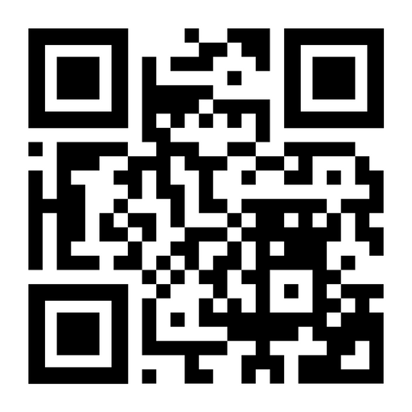

Responsible Use Guidelines
Before you share with AI, pause and check:
⛔ No personal, student, or institutional data.
🔍 Fact-check all outputs for accuracy & bias.
🧭 Stay transparent - note AI assistance if significant.
💡 Use judgment: would you show this to your supervisor?
🧠 Keep learning - AI policies evolve quickly.
📲 Scan for Wake Tech’s AI guidelines & sample privacy language.

Slide 37
Key Takeaways
3 Things to Remember
🎯Be specific ⟶ Define the role, task, & outcome.
🔄️Iterate ⟶ Don’t settle for draft #1 - refine until it fits.
⚖️Stay Responsible ⟶ Protect data, verify facts, honor ethics.
✨ Prompt clearly · Iterate often · Think critically.
📲 Scan for Wake Tech’s AI guidelines & sample privacy language.

Slide 38

Key Takeaways
3 Things to Remember
🎯Be specific ⟶ Define the role, task, & outcome.
🔄️Iterate ⟶ Don’t settle for draft #1 - refine until it fits.
⚖️Stay Responsible ⟶ Protect data, verify facts, honor ethics.
✨ Prompt clearly · Iterate often · Think critically.
What’s one way I’ll use AI differently after today?
📲 Scan for Wake Tech’s AI guidelines & sample privacy language.

Slide 39
THANK YOU!!
Email: abanks6@waketech.edu
Presented By:
Allison Banks

