Slide 1
Journals in Blackboard Ultra
AI and
Adaptive Techniques
Allison Banks, Instructional Designer – abanks6@waketech.edu
Allison Banks
Instructional Designer

Slide 2






Agenda / Objectives
Agenda
Agenda
Welcome Agenda / Objectives Context Setting Overview of AI Tools for PBL AI Design Assistant in Ultra Modules Prompts Rubrics Adaptive Learning Modules Ultra Activities | AI Conversations Ultra Activities AI Prompt Engineering Activities Discussion / Q & A Key Takeaways References Contact
Goal / Objective
Identify practical steps for designing AI-based PBL activities that are accessible, inclusive, & enhance student-centered learning.
MENU

Slide 3





Context Setting
PBL emphasizes student-centered learning by engaging learners in
Real-world problems
Critical thinking
Collaboration
Self-directed learning
AI offers innovative solutions to enhance PBL by
Automating administrative tasks
Providing personalized learning experiences
Facilitating collaborative tools
Importance
of PBL
AI Tools & Relevance to PBL
Challenges in Online Learning
Maintaining student engagement
Addressing varied learning styles
Fostering collaboration in virtual environments
MENU

Slide 4


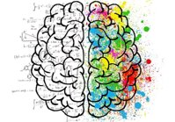



Overview of AI Tools for PBL
AI in Online Learning
Integrating AI into courses can lead to benefits such as
Increased student engagement
Personalized learning pathways
Improved assessment & feedback mechanisms
Menu of AI Technologies
AI Design Assistant
Adaptive Learning Modules
AI Conversations
AI Prompt Engineering
MENU

Slide 5


AI Design Assistant in Ultra
💡 Customizes Learning Paths Suggests resources & content that match different problem-solving styles, helping students engage in ways that suit their individual approaches & skill levels. | 🔎 Real-Time Feedback & Assessment Set up quizzes & assessments to provide students with immediate feedback, allowing them to adjust their approach as they progress.
💬 Supports Collaboration & Communication Suggests tools for collaboration & prompts for group reflection, helping students communicate & manage projects effectively. | 📊 Provides Data-Driven Insights Analyzes engagement data, helping instructors refine the learning experience & add resources for challenging areas.
🤝🏻 Enhances Accessibility & Inclusivity Suggests accessible resources, ensuring all students can participate fully in problem-based learning activities. | 🧠 Facilities Reflection & Metacognition Offers prompts for self-evaluation, fostering students’ metacognitive skills & their ability to assess their learning process.
AI Design Assistant
Modules
Prompts
Rubrics
MENU

Slide 6
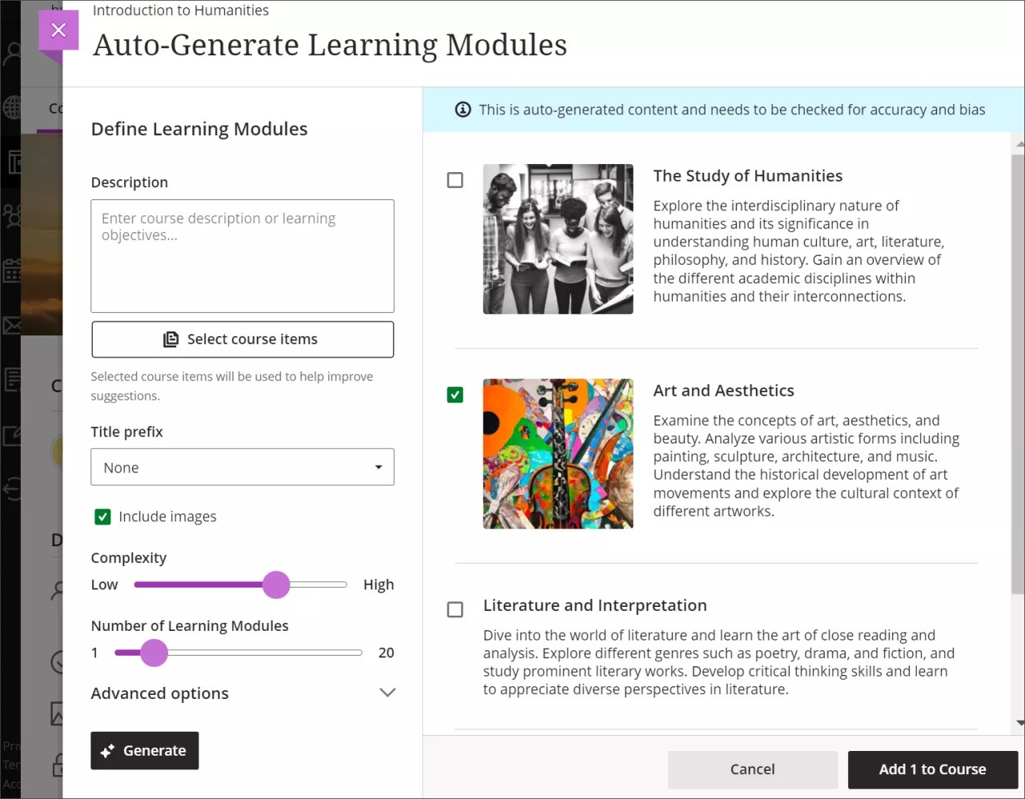
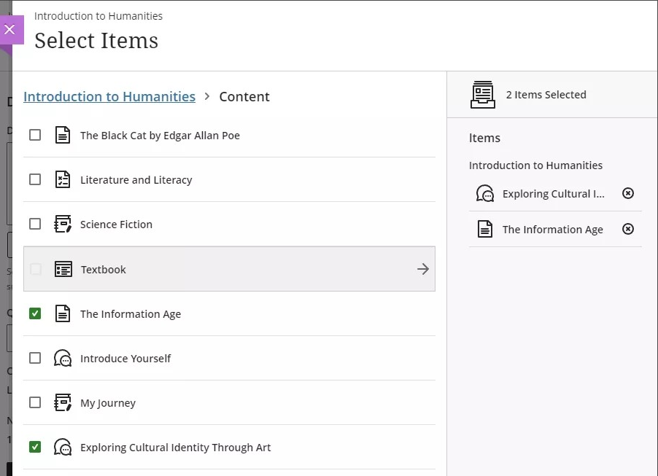

AI Design Assistant in Ultra
Generated Modules
You can also select course items you’d like the AI Design Assistant to use to provide context for new learning modules.
⭐ Helpful Features⭐
AI-generated images
Adjust complexity
Numerous modules
AI Design Assistant
Modules
Prompts
Rubrics
MENU

Slide 7

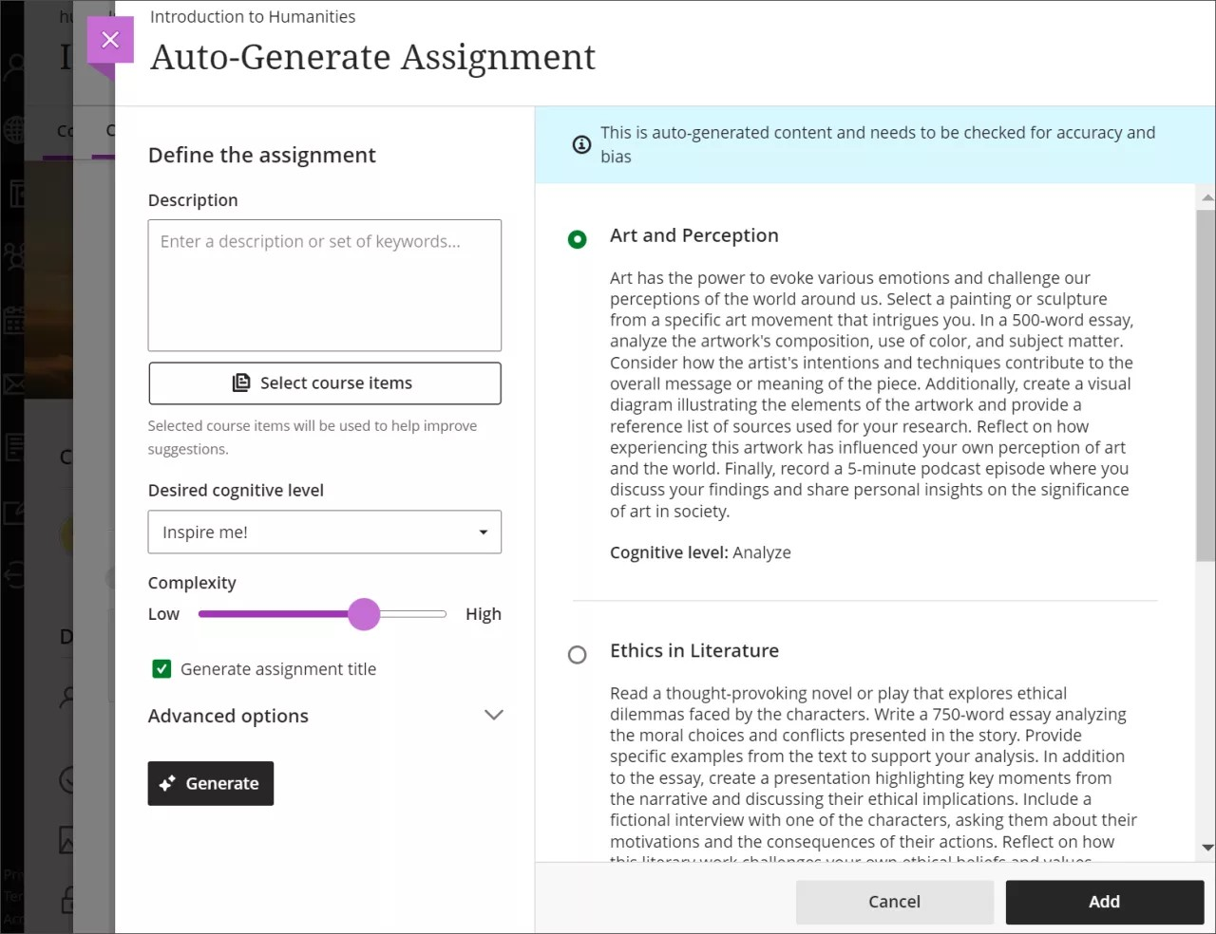

AI Design Assistant in Ultra
Generated Prompts
⭐Key Features⭐
Generates three assignment prompts for you to choose from
You can select course items you’d like the AI Design Assistant to use for context with the assignment prompts
Can be used with Assignments, Discussion Boards, & Journals!
Write a description to narrow the focus of the prompts
Select the desired cognitive level
Adjust the complexity of the prompts
AI Design Assistant
Modules
Prompts
Rubrics
Select whether you want to generate a title for the prompts
MENU

Slide 8
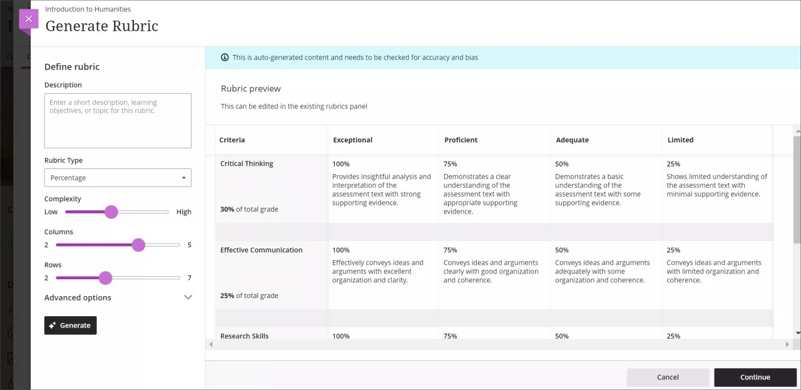

AI Design Assistant in Ultra
Generated Rubrics
AI Design Assistant
Modules
Prompts
Rubrics
Enter a description of the assignment
Select the rubric type
Adjust the complexity
Define the number of columns & rows
MENU

Slide 9
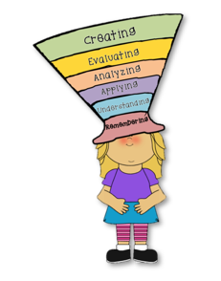


Adaptive Learning Modules
💡 Customizes Learning Paths Adaptive modules adjust activities based on each student’s progress & needs, allowing them to focus on foundational or advanced content. | 🔎 Relevant Resources & Reinforcement Relevant resources & reinforcements when students encounter challenges, helping them maintain momentum.
🧠 Encourages Self-Directed Learning Let students control their learning pace, promoting self-directed progress aligned with the student-centered approach of PBL. | 🔁 Ongoing Formative Assessment Students receive instant feedback on activities, allowing them to refine their approach & stay aligned with learning outcomes.
💬 Promotes Collaboration Instructors can group students at similar levels for collaboration, enhancing peer learning & supporting cohesive group problem-solving. | ✔️ Real-Time Student Progression Analytics help instructors monitor progress & provide personalized support.
1
MENU

Slide 10
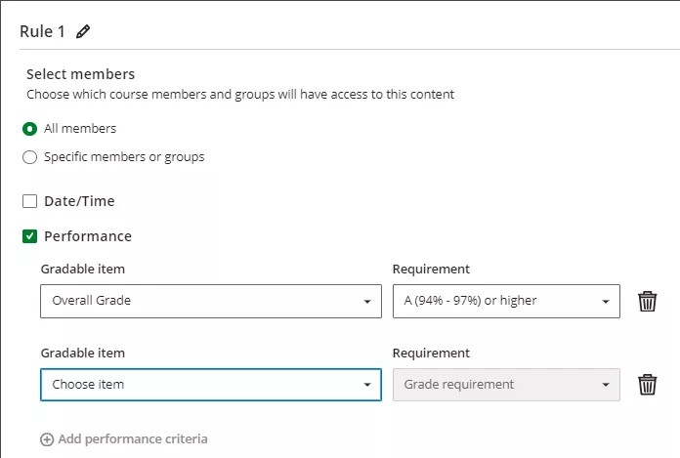
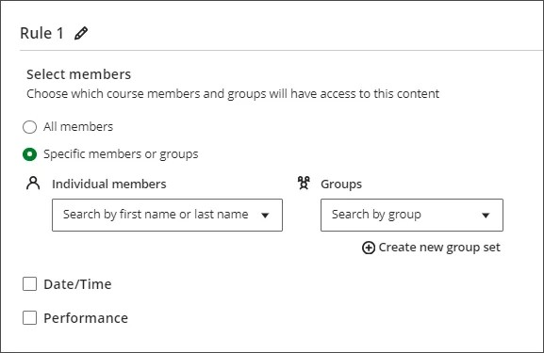


Adaptive Learning Modules
Performance Release
Group / Individual Release
Activity Ideas
Self-Paced Mastery Challenges
Concept Review & Strengthening
Progress Tracking & Reflection
MENU

Slide 11

Adaptive Learning Modules
🧠 Self-Paced Mastery Challenges
Create a series of self-paced mastery modules that cover core skills. Students work through each module independently & can only advance after demonstrating mastery through formative assessments. As they progress, each module builds on the last, reinforcing their understanding.
Geometry Example:
Students start with a module on basic shapes & properties.
After achieving mastery in these basics…
Module on angles, area, & more complex figures.
Each module adapts to student responses, providing additional support in areas where students struggle.
🎯 Targeted Knowledge Refreshers
Have students participate in a targeted concept review module that addresses content from previous lessons. The module assesses their understanding & adapts to reinforce areas where they may need a refresher, providing quick practice before new material is introduced.
Biology Example:
Students complete a weekly review module that revisits past topics like cell structure or ecosystems.
If they struggle with certain concepts, the module offers additional examples or questions to clarify.
🧐 Reflection Checkpoints
Set up regular reflection checkpoints within the modules where students review their recent work & performance. Students identify feedback on their strengths & areas for improvement. Students write a brief reflection on their progress & next steps.
Chemistry Example:
Students complete reflection questions every two weeks, summarizing what concepts felt difficult & how they overcome these challenges.
The module suggests additional exercises, resources, and/or strategies for challenging areas.
MENU

Slide 12


AI Conversations
🌎 Real-World Contexts Role-play simulations immerse students in realistic scenarios, helping them see how theoretical knowledge applies practically to real-world issues. | 🔎 Encourages Active Problem-Solving Simulations require students to analyze, decide, & anticipate outcomes, fostering critical thinking as they tackle open-ended PBL challenges.
💬 Enhances Communication Skills Simulations can mirror professional environments, helping students develop effective communication skills | 🤔 Promotes Perspective Students learn to view issues from multiple perspectives, building empathy & a nuanced understanding of viewpoints.
🧠 Immediate Application of Knowledge apply knowledge in real-time, with feedback from peers or instructors, reinforcing learning & identifying knowledge. | 🕹️ Interactive Learning Simulations enhance interactivity & engagement, which is particularly valuable in PBL to sustain motivation on complex, long-term projects.
Role Play Simulation for AI Conversation
NEW!!!
MENU

Slide 13

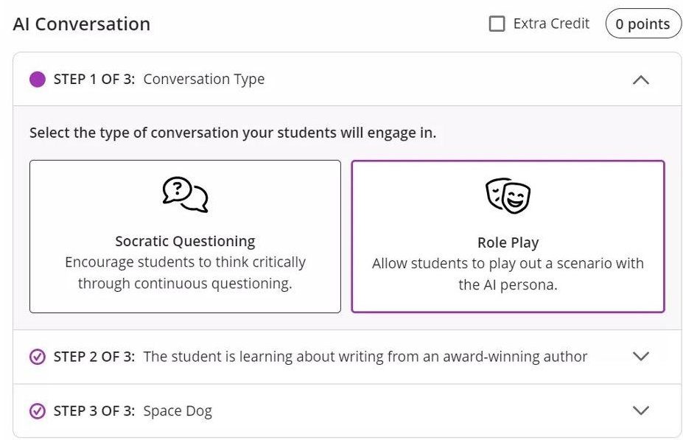
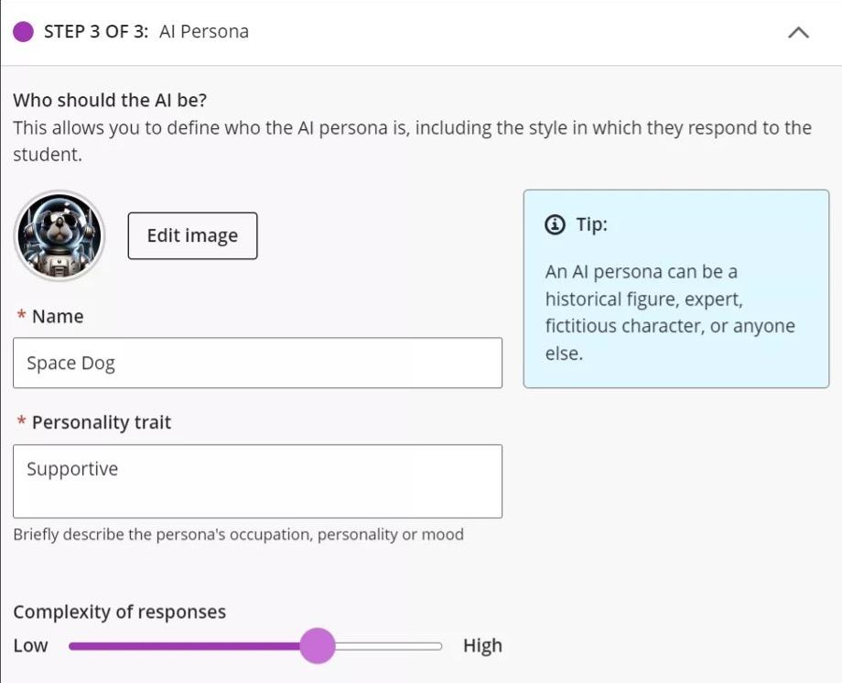
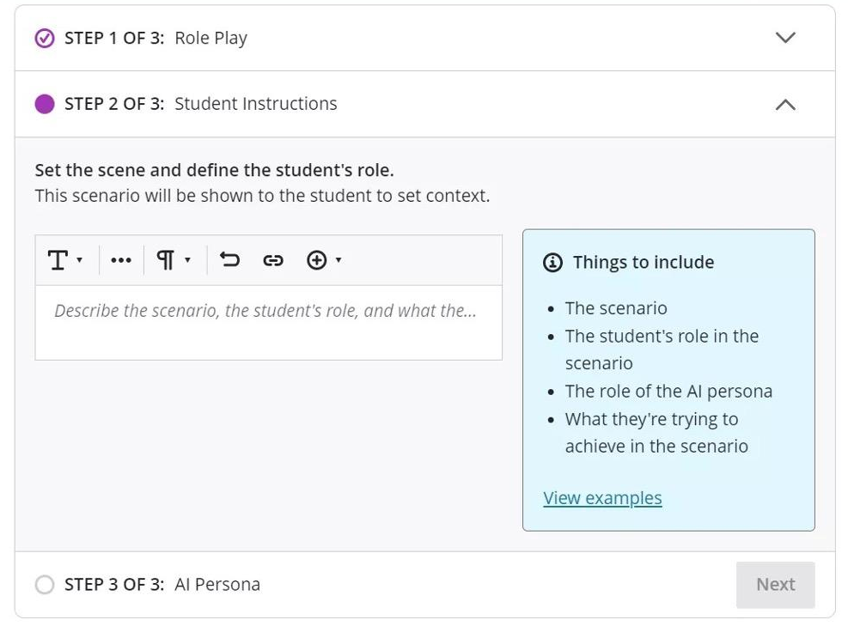

AI Conversations
AI Conversations
NEW!!!
1
2
3
Activity Ideas:
Debate Partner
Role Playing
Problem-Solving Scenarios
Analyzing Bias
MENU

Slide 14



AI Conversations
👯 Debate Partner
Activity: Students are assigned a debate topic. They can use AI to explore both sides of the argument, generating ideas, counterpoints, & examples.
Each student or group then organizes their points & engages in a classroom discussion board.
💬 Role-Playing
Activity: Assign students roles (e.g., a journalist, a detective, a historian) & have them use AI to simulate interviews with "historical figures," "scientific experts," or "fictional characters."
They can practice asking questions, following up based on responses, & refining their lines of inquiry.
🎯 Problem-Solving Scenarios
Activity: Present students with a real-world problem (e.g., environmental conservation, community planning) & ask them to brainstorm solutions by engaging in a Q&A with AI.
They must guide the AI to generate insights & suggestions, then synthesize these into a proposed solution.
💡 Analyze Bias in AI
Activity: Present a series of prompts related to a controversial topic, & have students analyze the AI’s responses for bias or assumptions.
This activity can prompt a discussion about how AI is trained, the impact on data sources, & a critical analysis of information sources.
MENU

Slide 15
AI Prompt Engineering
💡 Enhances Critical Thinking & Precision Crafting effective prompts requires students to refine their questions, improving clarity & focus for more precise AI responses that align with project needs. | 🧠 Encourages Iterative Problem-Solving students test & adjust prompts, supporting PBL by allowing exploration of multiple solutions before determining the best approach.
🔎 Improves Research Efficiency Effective prompts enable quick access to summaries, analyses, & data, letting students focus on applying insights rather than spending excess time gathering information. | 🎯 Encourages Deeper Engagement Thoughtful prompts inspire deeper, analytical AI responses, pushing students to engage with underlying concepts for a richer understanding of the problem.
✅ Promotes Adaptability Learning prompt engineering develops a versatile skill, aligning with PBL’s real-world focus & helping students adapt to evolving technologies in their careers. | 🧐 Enables Reflection & Self-Assessment Experimenting with prompts encourages self-reflection, allowing students to assess their question clarity & thinking patterns
MENU

Slide 16

AI Prompt Engineering
💡 Refining Inquiry with Iterative Prompting
Activity: Students experiment with different prompt formulations to improve AI responses. In each iteration, they refine their questions for clarity, specificity, or scope, noting how each prompt change affects the quality of AI feedback. They then present their best results & discuss the process.
Science Example: For a report on ecosystems, students start with a general question (“Tell me about ecosystems”) & gradually refine it to specific inquiries (“Explain the role of keystone species in rainforest ecosystems”).
✅ Prompt Feedback Loop & Analysis
Activity: In pairs, students create prompts related to a topic, record the AI’s responses, & share feedback with their partner on how to improve the prompt. After refining the prompt, they compare initial & improved responses, discussing what worked & why.
Psychology Example: Students create prompts to explore a topic like “factors influencing memory recall.” They analyze how minor wording changes (e.g., using “factors” vs. “reasons”) influence the AI’s detail & depth.
🎯 Designing Prompts for Creative AI Outputs
Activity: Ask students to generate prompts that lead the AI to provide creative responses, such as writing a narrative, brainstorming ideas, or creating analogies. They experiment with wording to maximize creativity in AI outputs & present their results in a creative writing piece or brainstorming assignment.
Literature Example: Students prompt the AI to “rewrite Romeo & Juliet in a modern setting” & adjust prompts to receive different styles, such as comedy or suspense.
MENU

Slide 17

Discussion / Q & A
Questions? Comments? Concerns?
MENU

Slide 18

Key Takeaways
AI Tools for Enhancing PBL
AI Design Assistant in Ultra
Adaptive Learning Modules in Ultra
AI Conversations in Ultra
AI Prompt Engineering
Register in GoSignMeUp!
Future AI Series Webinars
AI Generated Visuals
Four Approaches to Assignment Design in the Age of AI
Using AI in a Student-Centered Classroom
Artificial Intelligence and Prompt Engineering
Enhancing Instructor Productivity with ChatGPT
AI Tools enhance PBL by…
Personalizing experiences
Providing real-time feedback
Promoting critical thinking
Supporting self-directed learning
Fostering engagement
MENU

Slide 19
References
Adobe. (2024, August). The impact of AI in eLearning: Transforming education for the digital age. Retrieved from https://elearning.adobe.com/2024/08/the-impact-of-ai-in-elearning-transforming-education-for-the-digital-age/
Anthology. (2024, November). What’s new in Blackboard? Retrieved from https://www.anthology.com/blog/whats-new-in-blackboard-november-2024
Blackboard. (n.d.). AI Design Assistant. Retrieved from https://help.blackboard.com/Learn/Instructor/Ultra/Course_Content/Create_Content/AI_Design_Assistant
Chan, C. K. Y., & Hu, W. (2023). Students’ voices on generative AI: Perceptions, benefits, & challenges in higher education. International Journal of Educational Technology in Higher Education, 20(1), 43-18. https://doi.org/10.1186/s41239-023-00411-8
ChatGPT. (n.d.). ChatGPT. Retrieved from https://chatgpt.com/
Elicit. (n.d.). Elicit. Retrieved from https://elicit.com/
EI Design. (n.d.). AI in eLearning: How AI solutions will transform the industry. Retrieved from https://www.eidesign.net/ai-in-elearning-how-ai-solutions-will-transform-the-industry
Farshad, S., Zorin, E., & Amangeldiuly, N. et al. (2024). Engagement assessment in project-based education: A machine learning approach in team chat analysis. Education and Information Technologies, 29, 13105–13131. https://doi.org/10.1007/s10639-023-12381-5
ResearchRabbit. (n.d.). ResearchRabbit. Retrieved from https://researchrabbitapp.com
Savery, J. R. (2006). Overview of problem-based learning: Definitions & distinctions. Interdisciplinary Journal of Problem-Based Learning, 1(1). http://dx.doi.org/10.7771/1541-5015.1002
TOJET: The Turkish Online Journal of Educational Technology – July 2016, volume 15 issue 3. Design of a Problem-Based Online Learning Environment & Evaluation of its Effectiveness.
Utah Valley University. (n.d.). Project-Based Learning (PBL). Retrieved from https://www.uvu.edu/otl/resources/group_work/pbl.html#:~:text=While%20in%20Project%2Dbased%20Learning,distinction%20between%20the%20two%20concepts
MENU

Slide 20


Contact
Wake Tech E-Learning Support & Instructional Design
https://www.waketech.edu/online-learning/elsid
Allison Banks, Instructional Designer – abanks6@waketech.edu
MENU

